Slide 1

Array-Based Sequences
© 2013 Goodrich, Tamassia, Goldwasser
Array-Based Sequences
Notes:
Vectors

Slide 2
Python Sequence Classes
Python has built-in types, list, tuple, and str.
Each of these sequence types supports indexing to access an individual element of a sequence, using a syntax such as A[i]
Each of these types uses an array to represent the sequence.
  An array is a set of memory locations that can be addressed using consecutive indices, which, in Python, start with index 0.
A
0
1
2
i
n
© 2013 Goodrich, Tamassia, Goldwasser
Array-Based Sequences

Slide 3
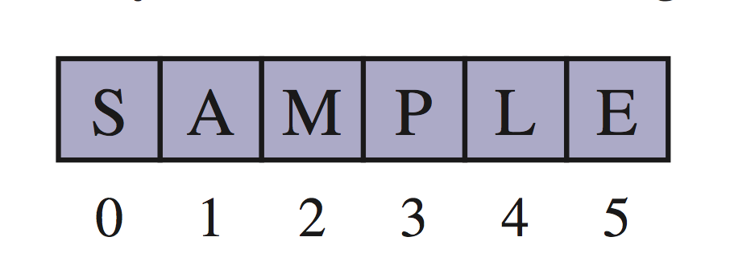
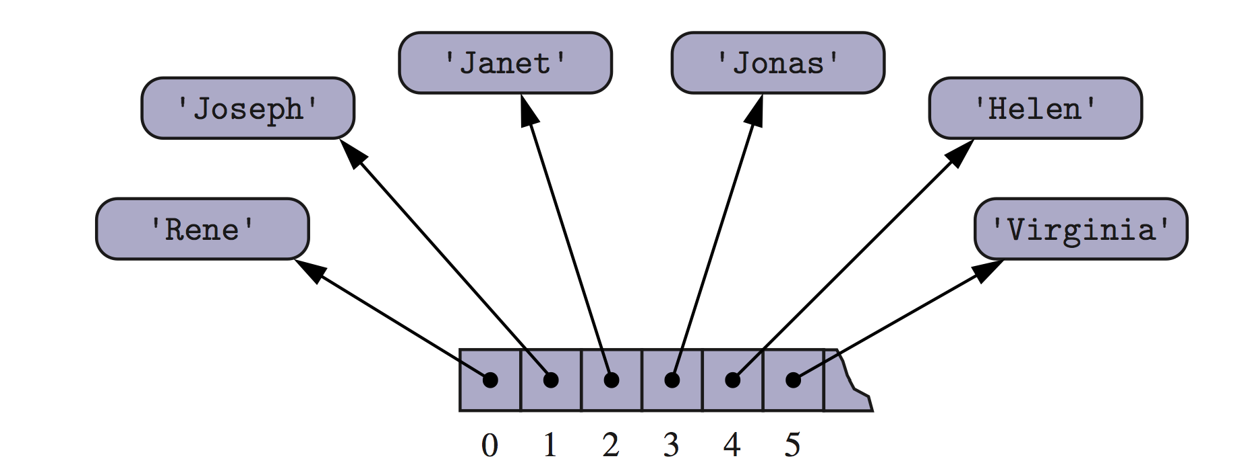
Arrays of Characters or Object References
An array can store primitive elements, such as characters, giving us a compact array.
An array can also store references to objects.
© 2013 Goodrich, Tamassia, Goldwasser
Array-Based Sequences

Slide 4
Compact Arrays
Primary support for compact arrays is in a module named array.
  That module defines a class, also named array, providing compact storage for arrays of primitive data types.
The constructor for the array class requires a type code as a first parameter, which is a character that designates the type of data that will be stored in the array.
© 2013 Goodrich, Tamassia, Goldwasser
Array-Based Sequences

Slide 5
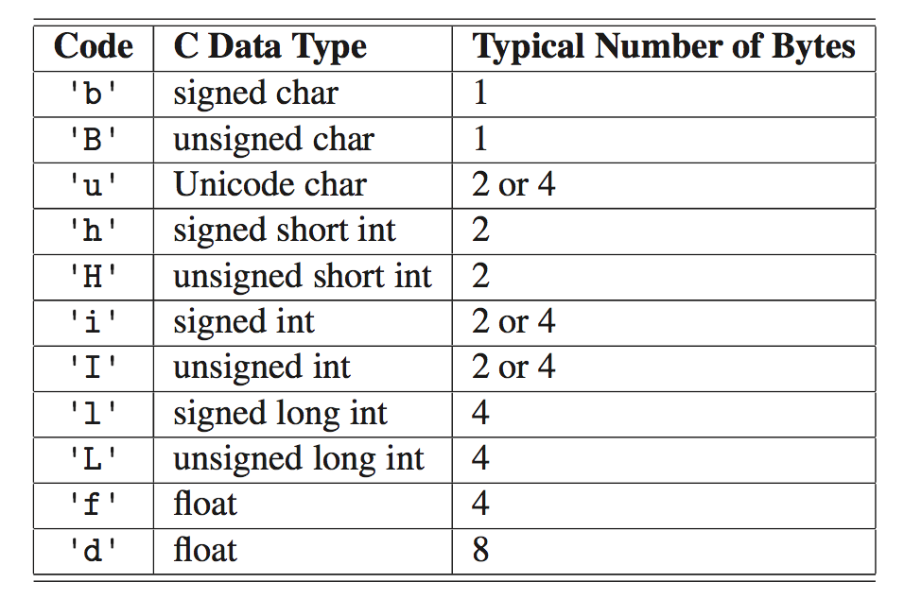
Type Codes in the array Class
Python’s array class has the following type codes:
© 2013 Goodrich, Tamassia, Goldwasser
Array-Based Sequences

Slide 6
Insertion
In an operation add(i, o), we need to make room for the new element by shifting forward the n − i elements A[i], …, A[n − 1]
In the worst case (i = 0), this takes O(n) time
A
0
1
2
i
n
A
0
1
2
i
n
A
o
0
1
2
i
n
© 2013 Goodrich, Tamassia, Goldwasser
Array-Based Sequences

Slide 7
Element Removal
In an operation remove(i), we need to fill the hole left by the removed element by shifting backward the n − i − 1 elements A[i + 1], …, A[n − 1]
In the worst case (i = 0), this takes O(n) time
A
o
0
1
2
i
n
A
0
1
2
i
n
A
0
1
2
i
n
© 2013 Goodrich, Tamassia, Goldwasser
Array-Based Sequences

Slide 8
Performance
In an array based implementation of a dynamic list:
  The space used by the data structure is O(n)
  Indexing the element at I takes O(1) time
  add and remove run in O(n) time in worst case
In an add operation, when the array is full, instead of throwing an exception, we can replace the array with a larger one…
© 2013 Goodrich, Tamassia, Goldwasser
Array-Based Sequences

Slide 9
Growable Array-based Array List
In an add(o) operation (without an index), we could always add at the end
When the array is full, we replace the array with a larger one
How large should the new array be?
  Incremental strategy: increase the size by a constant c
  Doubling strategy: double the size
Algorithm add(o)
if t = S.length − 1 then
A ← new array of
size …
for i ← 0 to n−1 do
A[i] ← S[i]
S ← A
n ← n + 1
S[n−1] ← o
© 2013 Goodrich, Tamassia, Goldwasser
Array-Based Sequences

Slide 10
Comparison of the Strategies
We compare the incremental strategy and the doubling strategy by analyzing the total time T(n) needed to perform a series of n add(o) operations
We assume that we start with an empty stack represented by an array of size 1
We call amortized time of an add operation the average time taken by an add over the series of operations, i.e., T(n)/n
© 2013 Goodrich, Tamassia, Goldwasser
Array-Based Sequences

Slide 11
Incremental Strategy Analysis
We replace the array k = n/c times
The total time T(n) of a series of n add operations is proportional to
n + c + 2c + 3c + 4c + … + kc =
n + c(1 + 2 + 3 + … + k) =
n + ck(k + 1)/2
Since c is a constant, T(n) is O(n + k²), i.e., O(n²)
The amortized time of an add operation is O(n)
© 2013 Goodrich, Tamassia, Goldwasser
Array-Based Sequences

Slide 12
Doubling Strategy Analysis
We replace the array k = log₂ n times
The total time T(n) of a series of n add operations is proportional to
n + 1 + 2 + 4 + 8 + …+ 2^{k} =
n + 2^{k + 1} − 1 =
3n − 1
T(n) is O(n)
The amortized time of an add operation is O(1)
geometric series
2
4
1
1
8
© 2013 Goodrich, Tamassia, Goldwasser
Array-Based Sequences

Slide 13
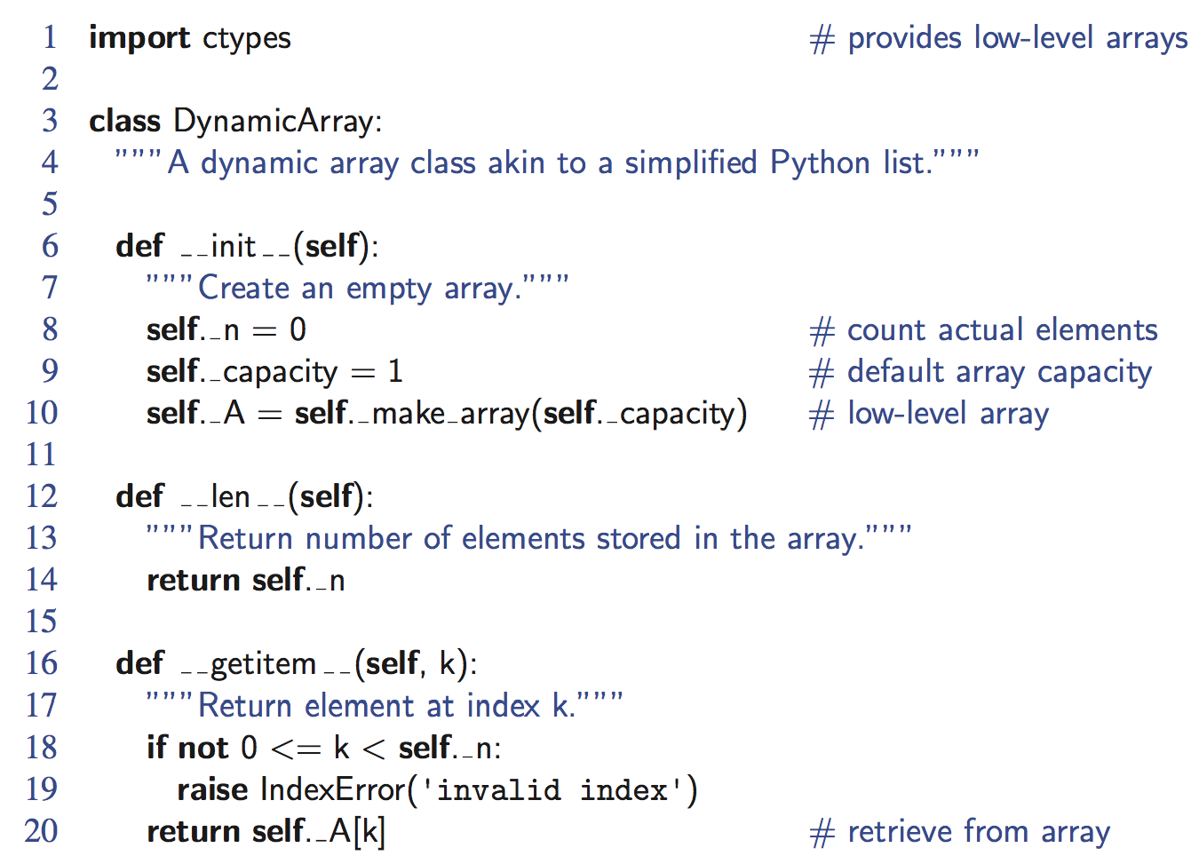
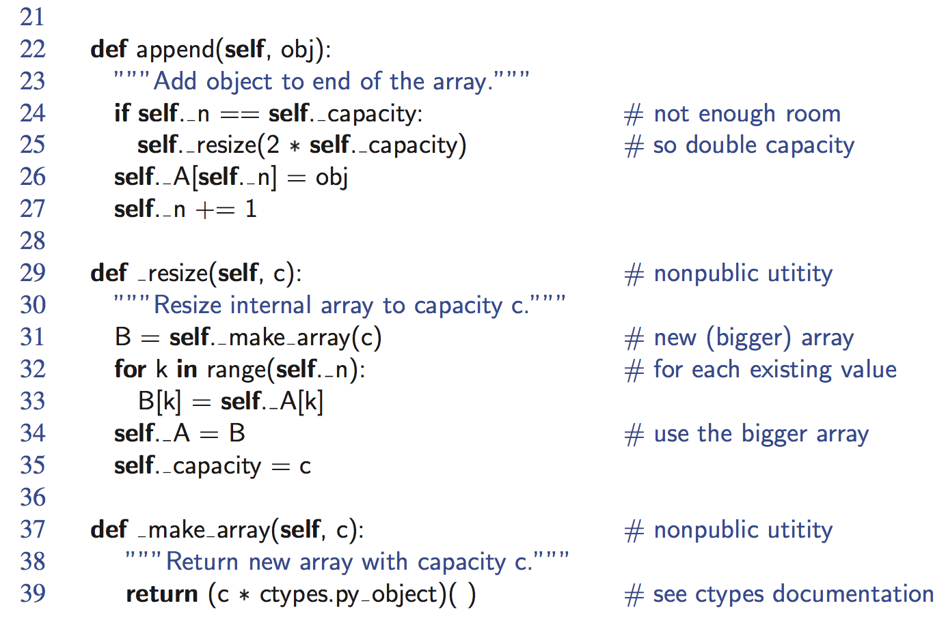
Python Implementation
© 2013 Goodrich, Tamassia, Goldwasser
Array-Based Sequences

